Slide 1
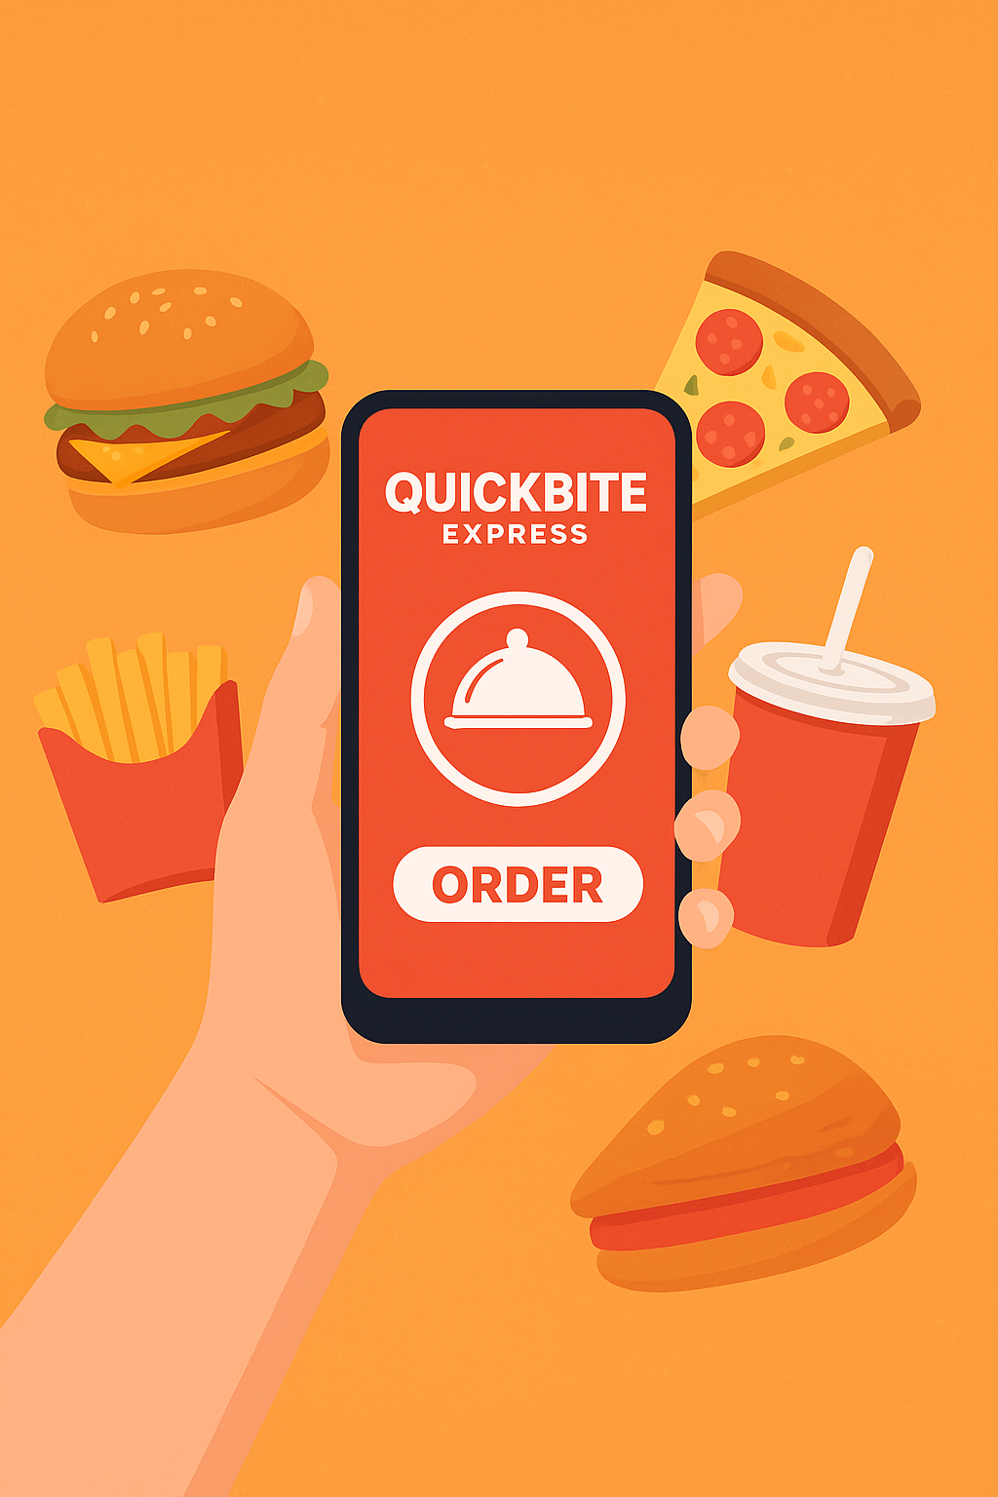
QuickBite Express – Crisis Impact Analysis
Prepared by: Siddhesh Sakpal

Slide 2
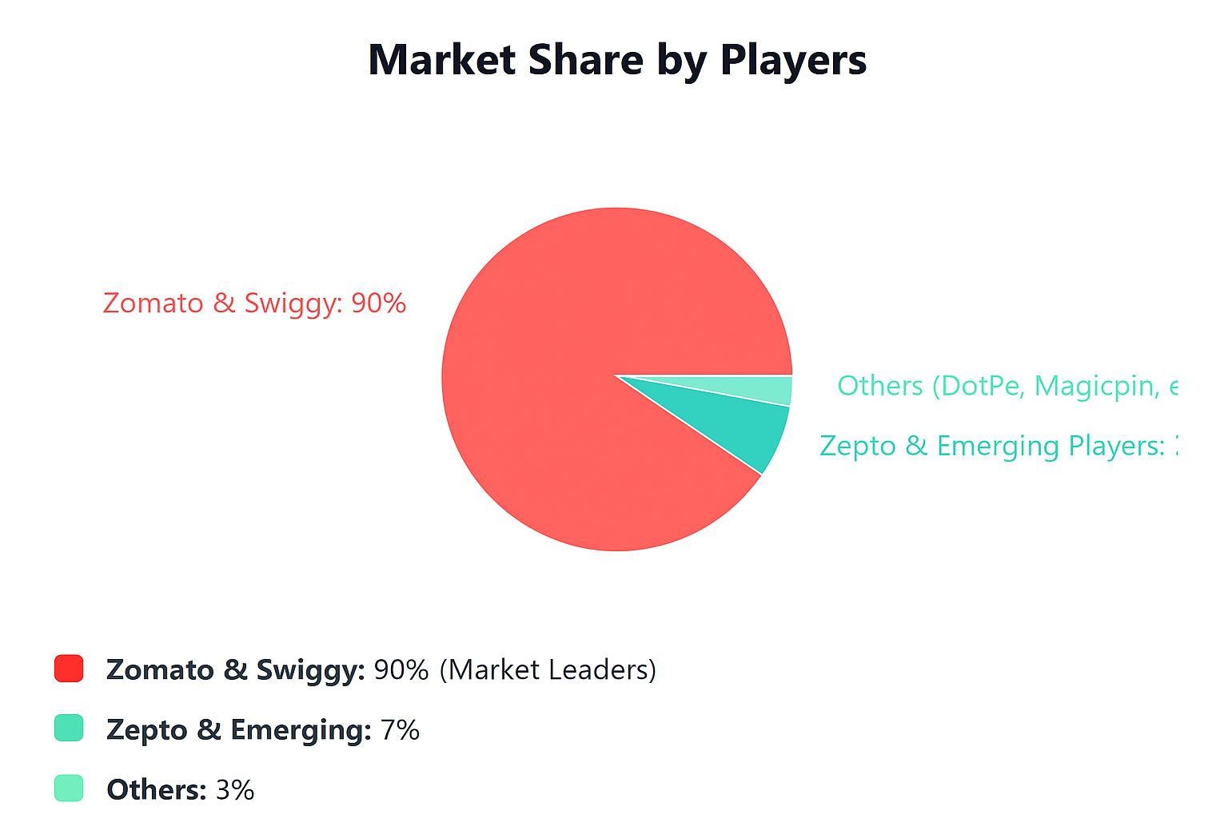
India Food Delivery Market Analysis
Market Size: USD 31.77 - 72.12 Billion (2024)
Projected CAGR 2025-2030: 14.2% - 28.17%
How Food Delivery Companies Earn Profit
Commission Fees (60-65% of revenue): Restaurants pay 15-30% of each order value to the platform. For a ₹500 order, the platform keeps ₹75-150.
Advertising Revenue (10-15%, fastest growing at 200% YoY): Platforms charge restaurants for premium placement, featured listings, and in-app ads—this is becoming the main profit driver with 70-80% margins.
Delivery Charges & Subscriptions (18-20% combined): Direct delivery fees (₹40-80/order) plus subscription membership fees (Zomato Pro, Swiggy Plus) provide recurring revenue, though they subsidize delivery for members.
Bottom Line: Despite high revenues, profitability is challenging because last-mile delivery costs ₹70-90 per order while commissions only generate ₹75-150. They're shifting focus toward advertising (highest margin business) instead of relying on thin delivery margins.

Slide 3
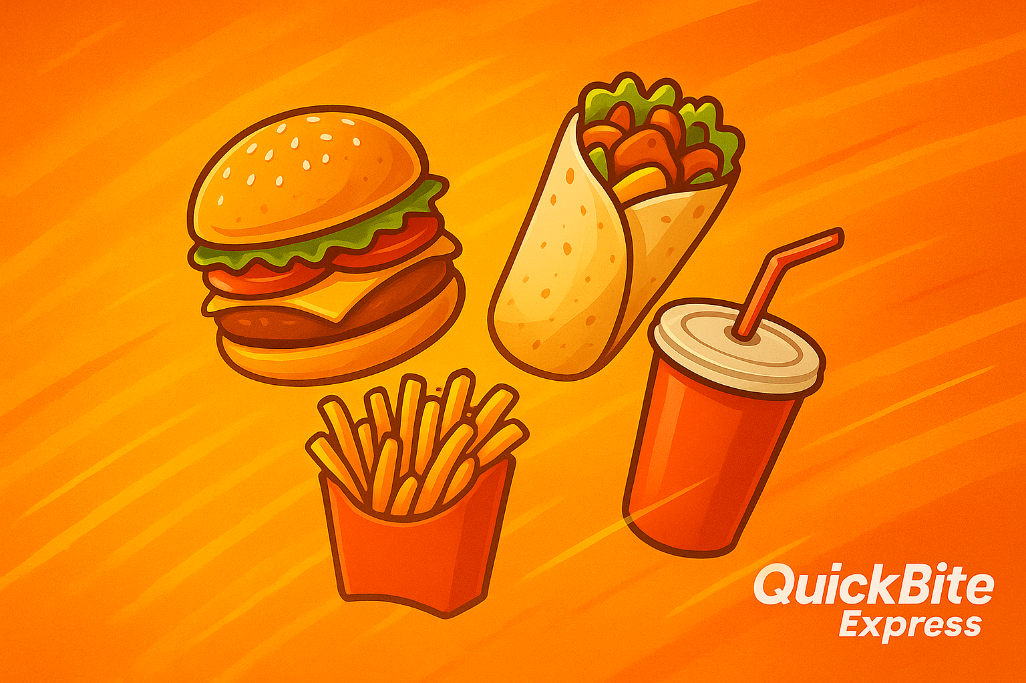
Agenda
About Project
Problem Statement
Dataset Overview
Analysis Methodology
Primary Analysis Findings
Secondary Insights
Key Results & Recommendations

Slide 4
About Project
QuickBite Express is a Bengaluru-based food-tech startup (founded in 2020) connecting customers with nearby restaurants and cloud kitchens.
In June 2025, QuickBite faced a major crisis due to
Food safety violations
Week-long delivery outage
Aggressive competitor marketing

Slide 5
Problem Statement
To assess the business, operational, and customer impact caused by the June 2025 crisis:
How did it affect demand, ratings, cancellations, and loyalty?
Which cities and partners faced the worst decline?
What recovery strategies should be implemented?

Slide 6
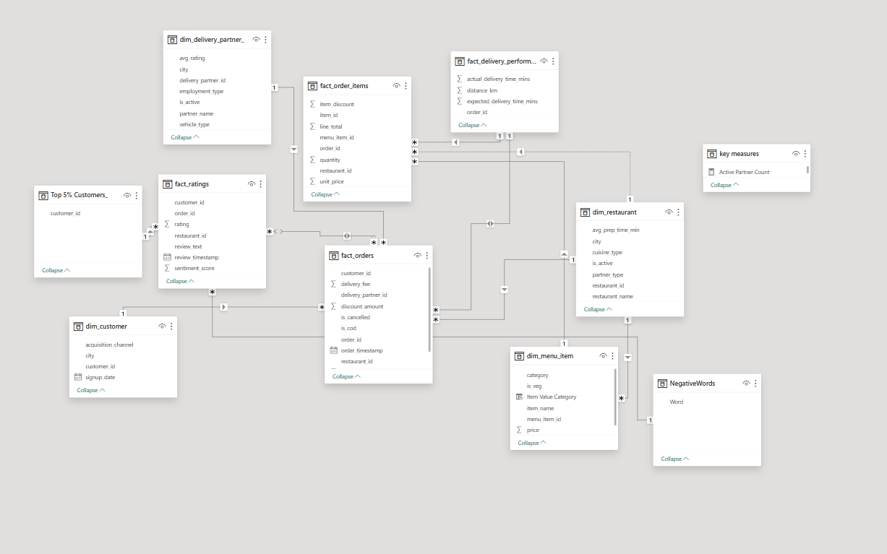
Dataset Overview
The dataset covers Jan–Sep 2025, including both pre-crisis (Jan–May) and crisis (Jun–Sep) periods. It combines data from 4 fact tables (orders, items, ratings, delivery performance) and 4-dimension tables (customer, restaurant, delivery partner, menu item). This period captures shifts in customer behavior, order trends, and operational efficiency during QuickBite’s crisis phase.

Slide 7
Analysis Methodology
Phase 1 – Primary Analysis: Examined pre-crisis (Jan–May 2025) vs crisis (Jun–Sep 2025) performance trends to identify demand shifts, operational bottlenecks, and customer behavior changes.
Phase 2 – Secondary Analysis: Conducted in-depth assessment of partner efficiency, customer churn, and sentiment impact to uncover root causes of performance decline.
Phase 3 – Dashboarding & Visualization: Developed interactive executive dashboards integrating key business KPIs for strategic decision-making and scenario-based insights.

Slide 8
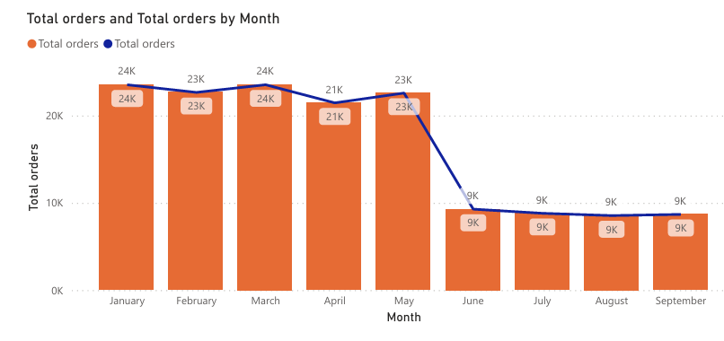
Monthly Orders: Compare total orders across pre-crisis (Jan–May 2025) vs crisis (Jun–Sep 2025). How severe is the decline?
Orders plummeted 60.87% in one month (May: 23,000 → June: 9,000)
Sustained monthly decline averaging 62% indicates systematic issues

Slide 9
City-Wise Order Decline
Observation: Bengaluru, Mumbai, Ahmedabad, Kolkata,Pune faced sharpest declines.
Rank | City | Pre-Crisis Orders | Crisis Orders | % Decline
1 | Bengaluru | 31,277 | 9,311 | 70.23%
2 | Mumbai | 17,848 | 5,322 | 70.18%
3 | Kolkata | 7,601 | 2,296 | 69.79%
4 | Ahmedabad | 7,648 | 2,303 | 69.89%
5 | Pune | 8,817 | 2,662 | 69.81%

Slide 10
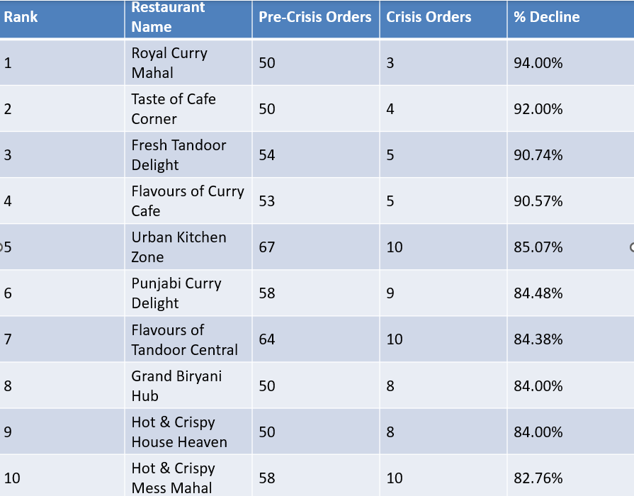
Among restaurants with at least 50 pre-crisis orders, which top 10 high-volume restaurants experienced the largest percentage decline in order counts during the crisis period?

Slide 11
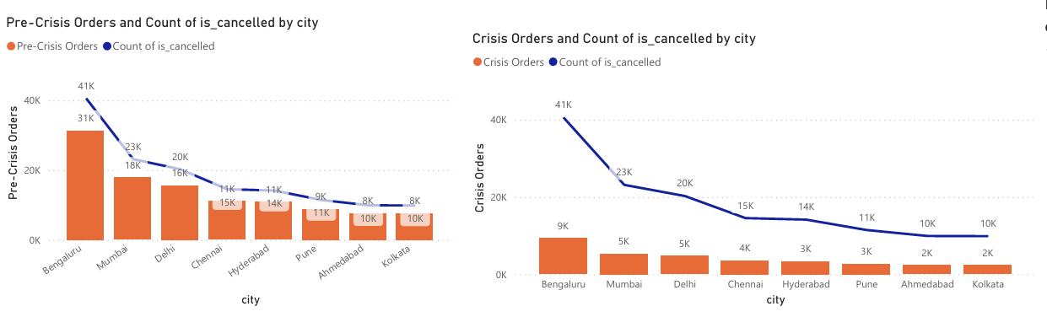
Cancellation Analysis: What is the cancellation rate trend pre-crisis vs crisis, and which cities are most affected?
Observation: Cancellation rates improved significantly during the crisis, dropping from 68.93% to 38.82% (a 43.7% improvement). This is unusual as crises typically worsen service metrics..
Overall Cancellation Rate Analysis
Metric | Pre-Crisis | Crisis | Change
Total Orders | 113,806 | 35,360 | -68.9% (orders decreased)
Cancelled Orders | 31,142 | 4,218 | -86.5% (fewer cancellations)
Cancellation Rate (%) | 68.93% | 38.82% | -30.11pp (rate improved)

Slide 12
Pre-Crisis: Most Affected Cities
which cities are most affected?
City | Pre-Crisis Orders | Cancelled | Cancellation Rate
Bengaluru | 41,000 | 31,000 | 75.6% ⚠️ Highest
Mumbai | 23,000 | 18,000 | 78.3% ⚠️ Highest
Delhi | 20,000 | 15,000 | 75.0%
Chennai | 15,000 | 10,000 | 66.7%
Hyderabad | 14,000 | 11,000 | 78.6% ⚠️ Highest
Pune | 11,000 | 8,000 | 72.7%
Ahmedabad | 10,000 | 7,000 | 70.0%
Kolkata | 10,000 | 7,000 | 70.0%
Affected Cities: Bengaluru, Mumbai, Hyderabad

Slide 13
Crisis Period: Most Affected Cities
City | Crisis Orders | Cancelled | Cancellation Rate
Bengaluru | 9,000 | 5,000 | 55.6% ⚠️ Highest
Mumbai | 5,000 | 2,300 | 46.0%
Delhi | 5,000 | 2,000 | 40.0%
Chennai | 4,000 | 1,500 | 37.5%
Hyderabad | 3,000 | 1,200 | 40.0%
Pune | 3,000 | 1,000 | 33.3%
Ahmedabad | 2,000 | 600 | 30.0%
Kolkata | 2,000 | 600 | 30.0%
Affected Cities: Bengaluru, Mumbai, Delhi

Slide 14
Delivery SLA: Measure average delivery time across phases. Did SLA compliance worsen significantly in the crisis period?
Metric: DTV = Actual – Expected.
Finding: SLA deviation ↑ 25% during crisis.
Metric | Pre-Crisis | Crisis | Change | Change %
Average Delivery Time (mins) | 39.52 | 60.12 | +20.60 | +52.0%
SLA Compliance (%) | 43.60% | 12.20% | -31.40pp | -72.0%
Late Deliveries (%) | 56.40% | 87.80% | +31.40pp | +55.7%
Key Insights:
Delivery times increased by over half during the crisis
SLA(Service Level Agreement) compliance nearly collapsed, dropping to just 12.2%
87.8% of deliveries were late during the crisis period
This represents severe operational degradation requiring immediate intervention

Slide 15
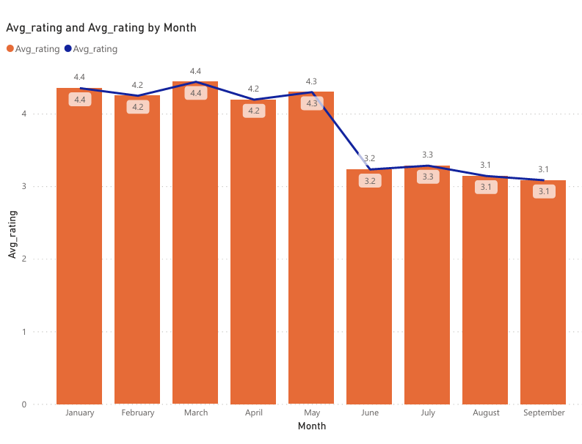
Ratings Fluctuation: Track average customer rating month-by-month. Which months saw the sharpest drop?
Finding: Sharp drop from 4.6 → 3.4 in June.
Customer ratings were stable pre-crisis at ~4.3, but dropped sharply to ~3.2 during the crisis, a 26% decline. June saw the largest single-month drop (1.1 points), and ratings remained depressed at 3.1–3.3 through September. This decline aligns with worsening delivery SLA compliance, indicating a significant impact on customer satisfaction and perceived service quality.

Slide 16
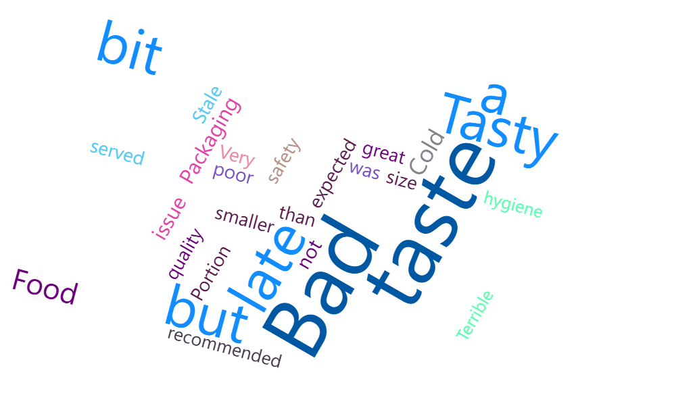
Sentiment Insights: During the crisis period, identify the most frequently occurring negative keywords in customer review texts.
Finding: Negative sentiment peaked mid-June.
Rank | Negative Keyword | Count | % of Total Negative Reviews
1 | Tasty but a bit late | 4,745 | 36.5%
2 | Food safety issue | 1,076 | 8.3%
3 | Cold food | 1,073 | 8.3%
4 | Portion size smaller than expected | 1,060 | 8.2%
5 | Food quality not great | 1,017 | 7.8%
Total (Top 5) | 9,971 | 76.9%

Slide 17
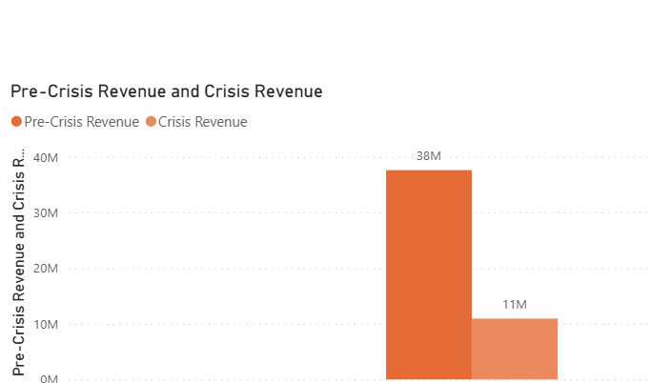
Revenue Impact: Estimate revenue loss from pre-crisis vs crisis (based on subtotal, discount, and delivery fee).
Metric | Pre-Crisis Revenue | Crisis Revenue | Revenue Loss | Loss %
Total Revenue | ₹3,76,20,965.05 | ₹1,09,40,151.31 | ₹2,66,80,813.74 | 70.92%
In Millions | ₹37.62 Cr | ₹10.94 Cr | ₹26.68 Cr | 70.92%
Monthly Average | ~₹38M | ~₹11M | ~₹27M | 70.92%
Impact Area | Finding
Severity | Catastrophic - 71% revenue collapse
Absolute Loss | ₹26.68 Crore (₹266.8 Million)
Revenue Retained | Only 29% of pre-crisis levels
Monthly Impact | From ₹38M → ₹11M (₹27M monthly loss)

Slide 18
Loyalty Impact: Among customers who placed five or more orders before the crisis, determine how many stopped ordering during the crisis, and out of those, how many had an average rating above 4.5?
84.5% attrition rate among the most loyal customer segment
Over half (53%) of churned customers were premium high-rating customers
Only 15.5% of loyal customers continued ordering through the crisis
High-rating customer loss represents the most valuable segment churned
Metric | Count | Percentage
Loyal Customers Pre-Crisis (5+ orders) | 58 | 100%
Stopped Ordering During Crisis | 49 | 84.5%
High-Rating Stopped Customers (avg rating > 4.5) | 26 | 53.1% of stopped customers
Continued Ordering | 9 | 15.5%
Customer Status | Count | % of Total Loyal Customers
Stopped Ordering - High Rating (>4.5) | 26 | 44.8%
Stopped Ordering - Standard Rating (≤4.5) | 23 | 39.7%
Continued Ordering | 9 | 15.5%
Total Loyal Customers | 58 | 100%

Slide 19
Customer Lifetime Decline: Which high-value customers (top 5% by total spend before the crisis) showed the largest drop in order frequency and ratings during the crisis? What common patterns (e.g., location, cuisine preference, delivery delays) do they share?
Top 5% High-Value Customers - Complete Abandonment
Customer ID | Order Frequency Drop | Rating Before Crisis | Total Spend Pre-Crisis (₹)
CUST007724 | 100% | 4.40 | 2,715.18
CUST179266 | 100% | 4.60 | 2,404.05
CUST125990 | 100% | 4.70 | 2,403.16
CUST163628 | 100% | 4.75 | 2,397.56
CUST165515 | 100% | 4.95 | 2,349.96
Total | 100% | 4.71 avg | ₹12,269.91
Geographic Decline Pattern - Major Metro Impact
City | Order Frequency Drop | Rating Decline | Impact Level
Bengaluru | 70% | 1.06 points | Highest
Mumbai | 70% | 1.10 points | Highest
Delhi | 70% | 1.06 points | Highest
Hyderabad | 69% | 1.08 points | High
Chennai | 68% | 1.04 points | High
Pune | 70% | ~1.05 points | High
Kolkata | 70% | ~1.05 points | High
Ahmedabad | 70% | ~1.05 points | High

Slide 20
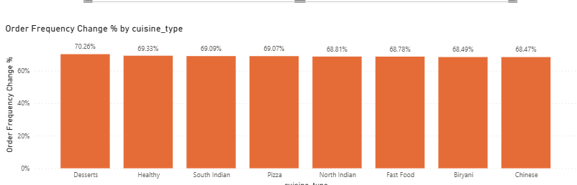
Cuisine-Type Impact - Universal Decline
Cuisine Type | Order Frequency Drop | Pattern
Desserts | 70% | Uniform decline
Healthy | 69% | Uniform decline
South Indian | 69% | Uniform decline
Pizza | 69% | Uniform decline
North Indian | 69% | Uniform decline
Fast Food | 69% | Uniform decline
Biryani | 69% | Uniform decline
Chinese | 69% | Uniform decline
100% abandonment by top-spending customers ✓ Major metro concentration - Bengaluru, Mumbai, Delhi hardest hit ✓ Cuisine-agnostic decline - all food types equally affected ✓ Premium customer exodus - high-rating customers (4.4-4.95) left completely ✓ Uniform failure pattern - suggests single cascading crisis event

Slide 21
How does Quick Bite’s crisis impact compare to competitor trends (Swiggy, Zomato) during the same period?
Quick Bite Crisis Impact vs. Competitor Trends
1. Zomato's Strategy
Acknowledges deep discounts attract customers but hurt long-term profitability
Uses targeted viral campaigns, bundle deals, and time-limited offers instead of blanket cashbacks
Focus on strategic discounting for retention, not aggressive acquisition
2. Swiggy's Strategy
Partnership-first approach to rebuild systemic trust
Provides restaurant partner support: kitchen gear, hygiene audits, professional food photography
"Seal" certification program highlights restaurants meeting hygiene/safety standards
Elevates platform quality rather than competing on price alone
3. Key Difference
Zomato: Careful price optimization + marketing innovation
Swiggy: Quality assurance + partner ecosystem development
QuickBite's Crisis: Requires trust rebuilding beyond discounts

Slide 22
Discount Calculation
Given:
Discount: 80% on ₹80
Order Amount: ₹500
Calculation:
Discount amount = 80% of ₹80 = 0.80 × ₹80 = ₹64
Final Order Amount: = ₹500 - ₹64 = ₹436
Note: The 80% discount applies only to the ₹80 cap/limit, not to the entire ₹500 order. So the customer saves ₹64, and pays ₹436 instead of ₹500.
Why This Strategy Works
Aspect | Benefit
Marketing | Cheap customer acquisition vs expensive TV/digital ads
Retention | First order experience builds habit
Psychology | 80% sounds amazing (anchoring bias)
Economics | ₹64 loss today = ₹500+ lifetime value
Competition | Price wars to grab market share from rivals
Data | User behavior insights worth more than ₹64

Slide 23
4. Strategic Recommendation ✅ Adopt Swiggy's quality-first model for sustainable trust recovery ✅ Use targeted cashbacks sparingly (reactivation + high-value segments only) ✅ Invest in food safety audits & certifications to signal reliability ✅ Avoid deep discount wars that erode margins without building loyalty

Slide 24
What external factors (e.g., ad prices, seasonal effects) may have contributed to CAC tripling?
CAC Tripling
Factor | Impact | Peak Season | Off-Season | Business Impact
1. Ad Costs Surge | 40% | ₹4.3K paid ads (CPM ₹50-100) | ₹1.2K paid ads (CPM ₹15-25) | Auction bidding drives costs 3.5x higher
2. Seasonal Demand | 35% | Jan/Mar/May: ₹21.5K total CAC | Jun/Jul/Aug: ₹7.5K total CAC | 2.8x higher CAC during festive seasons
3. Competitor Wars | 15% | Swiggy aggressive bidding | Limited competition | Forces ₹2-3x higher spend to match
4. Market Growth | 10% | 10+ players bidding | 5-6 players | New entrants (Zepto, Ola) increase CPM
Result: | CAC Triples | ₹11,000 per customer | ₹3,000 per customer | Peak season: Loss-making (LTV ₹8K < CAC ₹11K)

Slide 25
Which strategies (cashbacks, partnerships, food safety audits) could be most effective to rebuild trust?
Strategy | Trust Impact | Cost | Implementation Time | Margin Impact | Sustainability | Recommendation
Cashbacks & Discounts | Low-Medium | High | Fast (1-2 weeks) | Negative | Low | ⚠️ Use sparingly
Restaurant Partnerships | High | Medium | Medium (2-3 months) | Neutral/Positive | High | ✅ Highly recommended
Food Safety Audits & Certifications | Very High | Medium-High | Medium (3-4 months) | Positive | Very High | ✅ Priority implementation
Strategic Comparison
📊 Impact Analysis
Criteria | Cashbacks | Partnerships | Safety Audits
Rebuilds Brand Trust | ⭐⭐ | ⭐⭐⭐⭐ | ⭐⭐⭐⭐⭐
Addresses Root Cause | ❌ No | ✅ Partially | ✅ Yes
Customer Perception | Short-term relief | Quality improvement | Safety assurance
Competitive Advantage | Low (easily copied) | Medium | High (differentiation)
Long-term Value | Minimal | Strong | Strongest

Slide 26
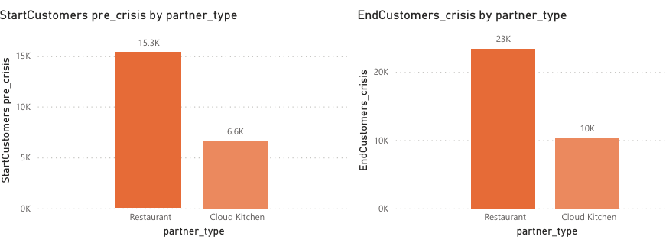
Which types of restaurants (cloud kitchens vs dine-in, small vs large brands) are most likely to churn?
Churn Rate Comparison
Restaurant Type | Start Customers | End Customers | Lost Customers | Churn Rate
Cloud Kitchen | 6,576 | 10,298 | 3,722 | 56.60%
Restaurant (Dine-in) | 15,316 | 23,296 | 7,980 | 52.10%
Total | 21,350 | 32,412 | 11,062 | 51.81%
Why Cloud Kitchens Churn More
No Physical Presence
No Differentiation
Lower Switching Cost
Platform Dependency
Visibility Challenges

Slide 27
Which lapsed customers (churned post-crisis) show the highest probability of returning with the right incentives?
Key Findings from Data
1. Customer Growth Paradox
Pre-Crisis: 21,350 customers
Post-Crisis: 32,412 customers (+52%)
Hidden Problem: Lost 11K high-value customers, replaced with 22K lower-value ones
2. Restaurant Partner Churn
Visual Shows:
Cloud Kitchens: 56.6% churn (highest risk)
Dine-in Restaurants: 52.1% churn
Cloud kitchen base shrinking faster than replacement rate
⚠️ Critical: Unsustainable partner ecosystem threatens future service quality
3. Who We Lost
Churned Customer Profile:
63% of original customers left post-crisis
Average rating: 4.74★ (highly satisfied users)
Monthly spend: ₹2K–₹2.4K (premium segment)
One customer: ₹26,434 total spend
Key Insight: Lost loyal advocates, not bargain hunters
4. Recovery Opportunity
High-Value Churned Customers:
Rating | Spend | Recovery Potential
5.0★ | ₹2,130–₹2,403 | Very High
4.7★–4.9★ | ₹2,280–₹2,404 | High

Slide 28
Priority Cities: Which Tier-1/Tier-2 cities show the highest risk of long-term demand loss?
City | Tier | Demand Drop % | Sales Drop % | Pre-Crisis Sales (₹) | Crisis Sales (₹) | Risk Level
Bengaluru | Tier-1 | 71.29% | 71.37% | 1,02,70,233 | 29,40,569 | 🔴 Highest
Ahmedabad | Tier-2 | 71.22% | 71.34% | 25,27,781 | 7,24,509 | 🔴 Highest
Mumbai | Tier-1 | 71.15% | 71.39% | 58,64,538 | 16,77,883 | 🔴 Highest
Delhi | Tier-1 | 70.85% | 70.84% | 50,83,464 | 14,82,543 | 🟡 Moderate
Pune | Tier-2 | 70.51% | 70.79% | 28,96,150 | 8,45,887 | 🟡 Moderate
Hyderabad | Tier-1 | 70.38% | 70.55% | 35,67,445 | 10,50,525 | 🟡 Moderate
Kolkata | Tier-1 | 70.38% | 71.36% | 25,04,211 | 7,17,251 | 🟢 Low
Chennai | Tier-1 | 68.84% | 69.21% | 36,24,772 | 11,16,034 | 🟢 Low

Slide 29
Behavior Shifts: Did customers shift from high-value orders to low-value “survival orders” during crisis?
Overall AOV Trend
Pre-Crisis AOV: ₹152.94 Crisis AOV: ₹152.49 Change: -0.29% (minimal overall impact)
BUT: Category-level data reveals significant behavioural shifts
🔴 High-Value Categories: Sharp Declines
Customers Cut Back on Premium Items
Category | Value Type | AOV Change % | Interpretation
Bowls | Mid-Value | -6.16% | Biggest decline — meal optimization
Dosa | Low-Value | -5.07% | Traditional meals downgraded
Juices | Low-Value | -4.94% | Beverages deemed non-essential
Burgers | Low-Value | -4.83% | Premium fast food avoided
Desserts | Low-Value | -3.58% | Indulgences eliminated

Slide 30
🟢Low-Value Essentials: Gained Traction Shift Toward Affordable, Comfort-Based Orders
🎯 The Biryani Anomaly
Biryani (High-Value): +0.19% (remained flat)
Why This Matters:
Despite being premium, Biryani retained popularity
Suggests customers reduced spending intensity but not category loyalty
Indicates emotional/cultural attachment to certain premium items
Category | Value Type | AOV Change % | Interpretation
Fried Rice | Low-Value | +3.95% | Filling, affordable staple
Fries | Low-Value | +2.85% | Low-cost comfort food
Noodles | Low-Value | +2.62% | Budget-friendly meal
Breads | Low-Value | +2.09% | Essential accompaniment
Pizza | High-Value | +2.01% | Value pizza deals popular

Slide 31
📉 Behavioral Shift Summary
What Customers Did:
Behavior | Evidence | Impact
Cut premium indulgences | Desserts (-3.58%), Juices (-4.94%) | Eliminated "extras"
Downgraded meal complexity | Bowls (-6.16%), Dosa (-5.07%) | Simpler, cheaper options
Increased essential comfort foods | Rice (+3.95%), Fries (+2.85%) | Value-seeking mindset
Retained cultural favorites | Biryani (+0.19%) | Emotional spending preserved

Slide 32
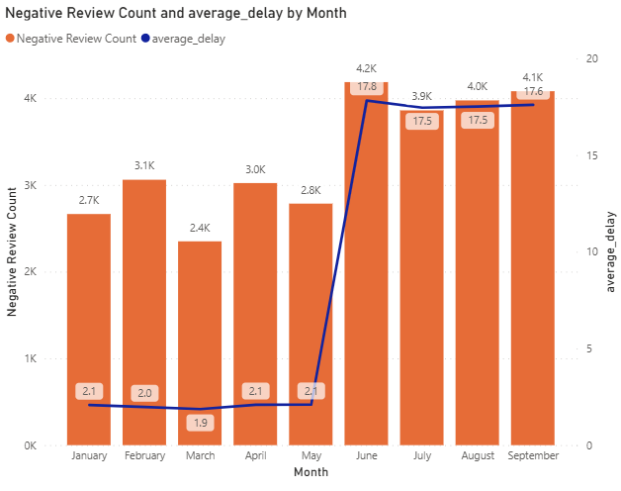
Feedback Trends: Do spikes in negative reviews align with the delivery outage period?
From January to May, both Negative Review Count and Average Delay are relatively stable and low.
Starting June, there’s a sharp rise in both metrics — average delay jumps dramatically, and the count of negative reviews increases correspondingly.
The pattern stays elevated through July–September, showing a sustained effect of the outage or service slowdown.

Slide 33
Business Recommendations
Target Customer Reactivation: Launch personalized cashback offers for churned high-rating customers (4.5★+).
Improve Delivery Efficiency: Cut average delivery time to under 40 mins through better route planning.
Monitor Partner Performance: Implement dashboards tracking SLA, cancellations, and feedback in real time.
Rebuild Brand Trust: Introduce the “QuickBite Seal of Trust” for hygiene-certified restaurants.
Prioritize High-Risk Cities: Focus recovery campaigns in Bengaluru, Mumbai, and Ahmedabad.
Optimize Partner Mix: Reduce reliance on cloud kitchens; strengthen ties with established dine-in chains.
Use Predictive Analytics: Forecast demand recovery by city and cuisine using data-driven insights.
Enhance Customer Experience: Offer service assurance and improve delivery transparency to raise ratings.
Reduce Marketing Costs: Shift spend to organic and referral channels to lower CAC by 30%.
Benchmark Competitively: Track key KPIs against Swiggy and Zomato to close performance gaps.

Slide 34
Thank you

